Slide 1
Agentic AI for Engineering
Lesson 2
Introduction to Agentic AI for Coding
Hands-on with ChatGPT Codex
Specify, generate, and verify changes with a coding agent
USAFA Instructor Short Course
Notes:
Lesson 2 connects the repo from Lesson 1 to a coding agent, ChatGPT Codex. The goal is a repeatable loop: specify a verifiable change, let the agent generate it on a branch, and verify it yourself before it reaches main. Everything we do today with beam-calc applies to your own course code in Exercise 7.

Slide 2
Lesson Objectives
By the end of this lesson you can:
Overview
1
Explain how a coding agent differs from a chat LLM, and how your role changes
2
Give an agent your project’s context with AGENTS.md
3
Specify a change as a verifiable requirement, and get a plan before any code
4
Review an agent’s diff and pull request, then verify the result yourself
5
Document GenAI use, and plan how cadets will use agents in your course
Agenda (50 min)
0–15 min
15–45 min
45–50
Concepts
Guided exercises in Codex
Review
Notes:
Lesson 1 gave everyone a repo on GitHub and the habit of working through branches and pull requests. This lesson puts a coding agent on the other side of that loop. The worked example continues with beam-calc so nobody is debugging unfamiliar code; the last exercise moves to each instructor’s own project. Emphasize objective 4: the engineer, not the agent, owns verification.

Slide 3
Prerequisites
Complete before class:
Overview
Lesson 1 repo
Your private copy of beam-calc on GitHub, cloned with GitHub Desktop.
Agent account
ChatGPT Plus or higher; Business, Edu, and Enterprise plans also include Codex. Use the account type your organization directs.
GitHub Desktop + VS Code
Installed and signed in (Lesson 1).
MATLAB (optional)
To run the tests yourself. The agent’s cloud environment has no MATLAB.
Your own project
The repo from Lesson 1’s Agent-Ready Checklist, for Exercise 7.
Follow current USAFA guidance on GenAI tools and data handling before you connect a repo to an agent.
Notes:
The agent account is the usual blocker; sort it out before class. Codex cloud comes with ChatGPT Plus and higher, including Business, Edu, and Enterprise workspaces; use whatever account type your organization directs. MATLAB is optional but strongly recommended: the agent cannot run MATLAB in its cloud environment, so the instructor is the only one who can execute the tests. That gap is the point of the Adjudicate step.

Slide 4
Chat LLM vs. Coding Agent
Chat LLM
LLM + tools
Coding agent
Answers in text. You copy, paste, and debug.
Writes and runs code in the chat. You still integrate it.
Reads your repo, edits files, runs commands, commits. You review.
Concepts
Chat LLM (copy/paste)
Coding agent (Codex)
Sees your code
Only what you paste in
Reads the whole repo itself
Edits code
You copy, paste, and merge by hand
Edits files and commits them to a branch
Runs commands
No
Yes, in a cloud environment (search, scripts)
Project rules
Re-explained in every chat
Written once in AGENTS.md, read every task
Your role
Integrator and debugger
Specifier, reviewer, and tester
An agent does more work per prompt. Each prompt needs a clearer specification, and each result needs a closer review.
Notes:
Most instructors have used chat LLMs. The shift is that the agent works directly in the repo, so the human job moves from integrating code to specifying and verifying it. That is the same shift we ask of cadets when they move from writing every line to engineering a system.

Slide 5
The Method
SPECIFY
GENERATE
IMPLEMENT
ADJUDICATE
Verifiable requirements
Agent proposes a design
Trusted tools make it real
Engineer owns the call
Concepts
ITERATE
The five workflow steps, for any coding agent:
1
Put your project in a GitHub repo (done in Lesson 1)
2
Open a task in Codex, Claude Code, or another coding agent
3
Connect your repo to the agent, with a context file (AGENTS.md)
4
Work with the agent to generate commits on a branch
5
Adjudicate the agent’s work yourself, and iterate
Notes:
Specify, Generate, Implement, Adjudicate, then Iterate. The agent is good at Generate. Specify and Adjudicate stay with the engineer; Implement means trusted tools (MATLAB, the compiler, test suites, hardware) turn the proposal into evidence. The five steps are the mechanics; every remaining slide maps to one of them.

Slide 6
Agent Tool Options
Tool
Where it runs
Access
Context file
ChatGPT Codex (this lesson)
Cloud environment from your GitHub repo; also app, CLI, VS Code
ChatGPT Plus plan or higher
AGENTS.md
Concepts
Claude Code
Cloud sandbox from your GitHub repo; also CLI and VS Code extension
Claude Pro plan or higher
CLAUDE.md (can import AGENTS.md)
GitHub Copilot agent mode
VS Code on your laptop; coding agent on GitHub
Copilot Free (limited) or paid plans
.github/copilot-
instructions.md
1
The five workflow steps are the same for every tool.
2
With a local agent, Exercises 2–3 become “open the repo folder in VS Code.” The agent edits your working copy; you review and commit in GitHub Desktop.
Plans and limits change often. Check each tool’s current plan page, and use the tools your organization approves.
Notes:
Codex cloud is the worked example because it runs entirely from a GitHub repo, which is what Lesson 1 set up, and because it reads AGENTS.md, which the beam-calc repo already has. The method transfers to any agent: Claude Code reads CLAUDE.md, which can import AGENTS.md with an @AGENTS.md line; Copilot reads its own instructions file. Lesson 4 uses Codex locally, in the VS Code extension. Verify current plans before recommending a tool to colleagues or cadets.

Slide 7
Example: Distributed Load
SPECIFY
Theory
STARTING POINT
Point load: δ = P L³ / (3 E I)
Your beam-calc repo from Lesson 1. beam.m computes cantilever tip deflection for a point load; tests/testBeam.m checks it.
Distributed: δ = w L⁴ / (8 E I)
Specify
Same beam, P = wL: the distributed result is 3/8 of the point-load result.
REQUIREMENT
beam-calc shall compute the tip deflection for a uniformly distributed load w (N/m) with a function tipDeflectionUDL(w, L, E, I), and beam.m shall print it below the point-load result.
% Hand check
w = 1000; L = 2.0;
E = 200e9;
I = 0.05*0.10^3/12;
% δ = 2.40 mm
VERIFICATION
Test: a new case in tests/testBeam.m matches the hand calculation within 0.1%, and runtests('tests') passes in MATLAB. The point-load result is unchanged.
Notes:
One small feature carried through every exercise. The requirement is written so it can be verified before any code exists: a named function, units, and a test with a tolerance. The hand check uses the Lesson 1 section (50 × 100 mm steel, L = 2 m), so it does not depend on what instructors changed in beam.m during Lesson 1. Point out the 3/8 ratio: an independent sanity check the agent did not write.

Slide 8
Exercise 1: Improve AGENTS.md
# AGENTS.md
## Project
- MATLAB R2024b, no toolboxes.
## About me
- Instructor. Fluent in MATLAB,
new to coding agents. Explain
each change before coding.
## Conventions
- SI units; comment the units
on every constant.
- One function per file.
## Environment and checks
- No MATLAB in your cloud
environment. List the checks
I must run myself.
- Never change an existing
result or test without asking.
EXERCISE
1
In VS Code, open AGENTS.md from Lesson 1. Extend it like the example, adapted to you.
2
Keep the Environment and checks section: it tells Codex what it can’t verify.
Setup
3
Commit to main: Update AGENTS.md. Push origin.
Codex reads AGENTS.md at the start of every task. Include what a new colleague would need.
Keep it short. Add a rule each time the agent repeats a mistake.
Notes:
AGENTS.md is the most effective single thing you can do to improve agent output. It is plain Markdown at the repo root, and instructors already wrote a first draft in Lesson 1; today they make it useful. About me sets the explanation level. The Environment and checks section matters most: Codex cannot run MATLAB in its cloud environment, so it should say what it could not verify instead of claiming the tests pass. Claude Code users can add a one-line CLAUDE.md containing @AGENTS.md to share the same rules.

Slide 9
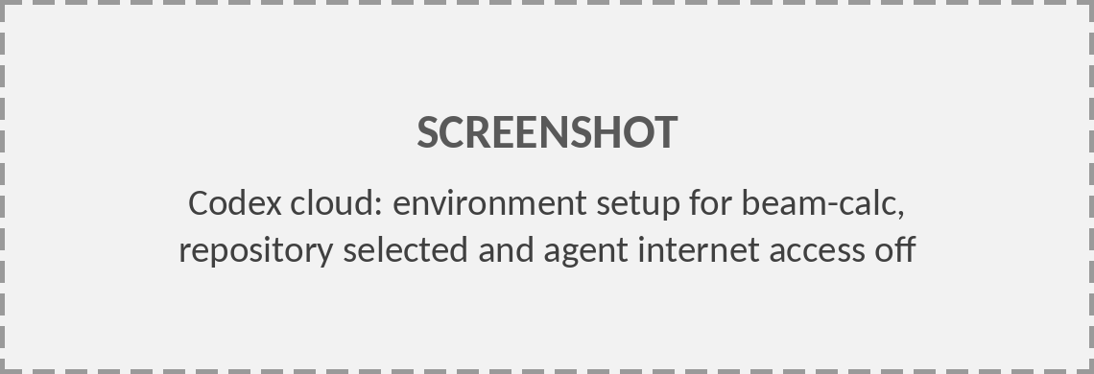
Exercise 2: Set Up Codex
Codex cloud
GitHub repo
Your laptop
cloud environment
shared source
Desktop + MATLAB
A Codex task can read and change your repo. It cannot reach your laptop, your MATLAB license, or any file outside the repo.
Setup
EXERCISE
1
Go to chatgpt.com/codex and sign in.
2
Connect GitHub when prompted. Give it access to your beam-calc repo only.
3
Create an environment for beam-calc. Leave agent internet access off.
4
Start a task on beam-calc and the main branch. Codex reads AGENTS.md automatically.
Notes:
Emphasize the architecture: the agent never touches the laptop. GitHub is the hand-off point between the Codex cloud environment and your machine, which is why Lesson 1 spent so long on push, fetch, and pull. Grant the GitHub connection access to selected repositories only, not your whole account. The Codex interface changes often; check the labels before class, but the steps stay the same: sign in, connect GitHub, set up an environment for the repo, start a task.
Screenshot to add: Codex cloud: environment setup for beam-calc, repository selected and agent internet access off (Replace the gray placeholder: right-click › Change Picture › From a File.)

Slide 10
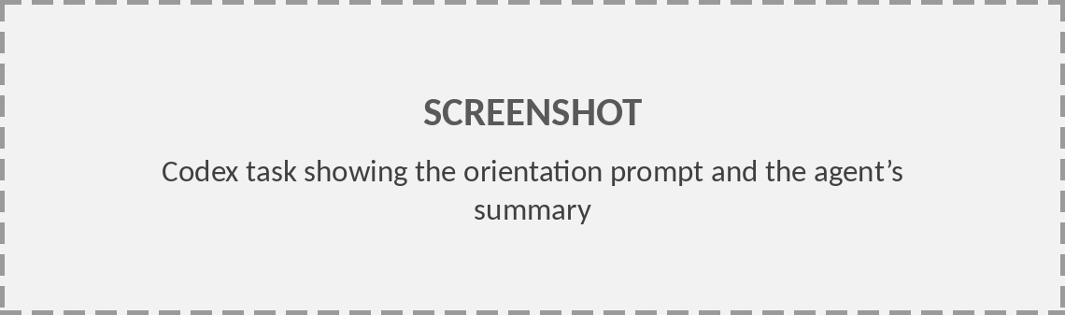
Exercise 3: Orient the Agent
EXERCISE
Send an orientation prompt before asking for any change:
YOU
Read AGENTS.md, beam.m, and tests/testBeam.m. Summarize what the code computes, its units, and how it is tested. Don’t change any files.
Setup
AGENT
beam.m computes the tip deflection of a cantilever under a point load, δ = PL³/(3EI), in SI units, and prints it in mm. tests/testBeam.m checks that result; run it with runtests('tests'). I can’t run MATLAB here, so I haven’t executed the tests.
Check the summary against the code. If the agent misunderstands the code now, its changes will be wrong too.
Notes:
The orientation prompt costs one message and tells you whether the agent understands the code. If the Codex interface offers an Ask (question-only) mode, use it here. A good answer names the formula, the units, the test, and its own limits. If the summary is wrong, fix AGENTS.md before going further.
Screenshot to add: Codex task showing the orientation prompt and the agent’s summary (Replace the gray placeholder: right-click › Change Picture › From a File.)

Slide 11
Exercise 4: Plan Before Code
EXERCISE
YOU
AGENT
Implement the requirement: add tipDeflectionUDL(w, L, E, I), δ = wL⁴/(8EI), print it from beam.m, and add a test against the hand calculation (2.40 mm).
Don’t write code yet. Give me a plan: files and functions you’ll change, and any questions.
Plan:
1. New file tipDeflectionUDL.m.
2. beam.m: add w = 1000 N/m; print the result after the point load.
3. tests/testBeam.m: add testUDLHandCalc.
Question: does w act over the full length?
Generate
YOU
Full length. Plan approved. Implement it and commit.
Check the plan for: expected files only · real MATLAB functions · questions answered by you, not guessed.
Notes:
Asking for a plan first is cheap and catches wrong assumptions before code is written. Good plans name files, functions, and open questions. The engineer answers the questions; the agent should not guess. Here the load extent is a real modeling decision that belongs to the instructor.

Slide 12
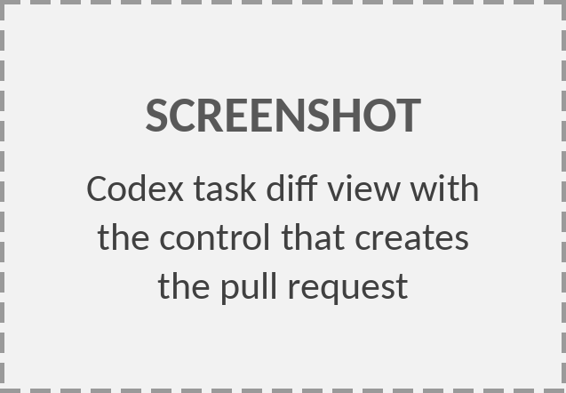
Exercise 5: Review the Diff
codex/udl-deflection · 3 files +12 −0
@@ tipDeflectionUDL.m (new) @@
+function d = tipDeflectionUDL(w, L, E, I)
+% Tip deflection, uniform load w (N/m)
+d = w*L^4/(8*E*I); % m
+end
@@ beam.m @@
fprintf('Tip deflection: %.2f mm\n', ...)
+w = 1000; % N/m, uniform
+dW = tipDeflectionUDL(w, L, E, I);
+fprintf('UDL deflection: %.2f mm\n', ...)
@@ tests/testBeam.m @@
+function testUDLHandCalc(tc)
+I = 0.05*0.10^3/12;
+d = tipDeflectionUDL(1000, 2.0, 200e9, I);
+verifyEqual(tc, d, 2.40e-3, 'RelTol', 1e-3)
+end
EXERCISE
1
Read every line. Green + lines were added; red − lines were removed.
2
Ask about anything unclear: Why RelTol 1e-3?
Generate
3
Create the pull request from the task.
You are accountable for every line you merge, as cadets are for every line they submit.
Notes:
Codex works on its own branch, never directly on main. Codex names the branch when you create the pull request, so yours will differ from codex/udl-deflection. Walk through the diff line by line. Look hardest at the test: an agent that writes both the code and its test can make them agree with each other and still be wrong. Here the expected value 2.40e-3 m comes from our hand calculation, not from the code. The ... in the fprintf lines is shortened for the slide.
Screenshot to add: Codex task diff view with the control that creates the pull request (Replace the gray placeholder: right-click › Change Picture › From a File.)

Slide 13
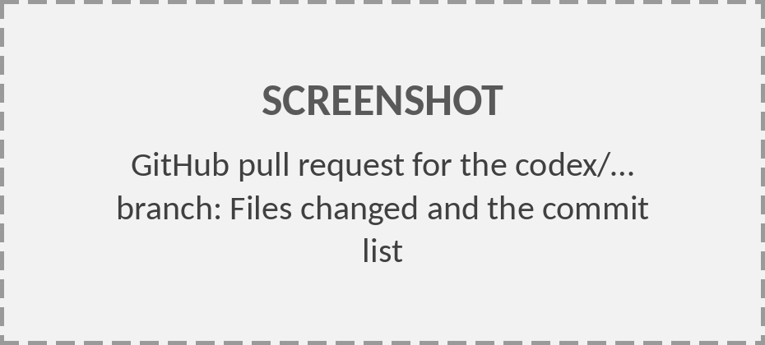
Agent Branches & PRs
Add UDL deflection
Fix test units
codex/…
a1b2c3d
e4f5a6b
main
Lesson 1 work
Merge PR
Generate
main
main
Branch
Pull request (PR)
Codex puts each task’s changes on their own codex/… branch when you create the pull request.
For fixes, ask in the task or comment @codex on the PR. main is unchanged until you merge.
1
Create the pull request from the task.
2
On GitHub, read Files changed.
3
Test the branch yourself (next).
4
Merge only after it passes.
Notes:
Same branches and pull requests as Lesson 1, with the agent as the other contributor. Codex never commits to main. The pull request is where the review happens, and where the change is merged after the test passes. To get a fix onto the same pull request, comment on it with @codex and the request; Codex starts a task with the PR as context and can push to its branch. Follow-ups inside the original task may or may not update the PR, depending on the current Codex interface.
Screenshot to add: GitHub pull request for the codex/… branch: Files changed and the commit list (Replace the gray placeholder: right-click › Change Picture › From a File.)

Slide 14
Exercise 6: Test It Yourself
EXERCISE
1
GitHub Desktop: Fetch origin, then switch Current branch to codex/udl-deflection.
2
MATLAB: open the repo folder. Run beam, then runtests('tests').
3
Check the result against your own hand calculation, not the agent’s.
Adjudicate
PASS CRITERIA (FROM THE REQUIREMENT)
All tests pass, including testUDLHandCalc.
Hand check: w = 1000 N/m, L = 2.0 m, steel, 50 × 100 mm → δ = 2.40 mm.
With P = wL, the distributed result is 3/8 of the point-load result.
The point-load line prints the same value as on main.
Until you run it, the agent’s commit is a proposal.
Notes:
This is the only step that tests the requirement. MATLAB and the test suite are the trusted tools; the hand calculation and the 3/8 ratio are independent checks the agent did not produce. If an instructor has no MATLAB, they can still review the test logic and the hand calculation, but should record the change as unverified.

Slide 15
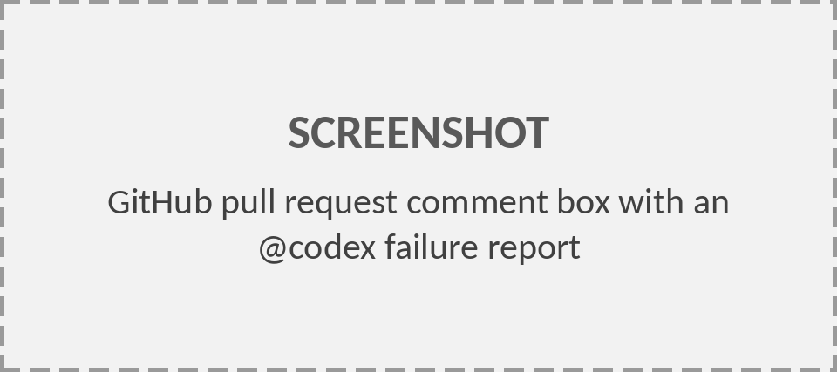
Iterate & Merge
ITERATE
If it fails
If it passes
Comment @codex on the PR with what you saw.
1
Merge the PR on GitHub.
2
GitHub Desktop: switch to main, Pull origin.
YOU
@codex testUDLHandCalc fails: expected 2.4000e-03, got 2.4000e-06. Output below. Find the cause and explain it before changing code.
[paste MATLAB output]
3
Start a new task for the next requirement.
Adjudicate
4
Add a rule to AGENTS.md for any mistake the agent made twice.
Codex pushes a fix to the PR’s branch. Fetch, rerun, retest.
Notes:
Failure reports should contain observations and logs, not just ‘it doesn’t work’. Commenting @codex on the pull request keeps the fix on the same branch and the discussion on the PR, where reviewers can see it. Asking for an explanation before a fix keeps the engineer in the loop and often exposes a wrong assumption (here, a section dimension entered in mm). One requirement per task keeps context small and commits easy to review.
Screenshot to add: GitHub pull request comment box with an @codex failure report (Replace the gray placeholder: right-click › Change Picture › From a File.)

Slide 16
Common Failure Modes
Failure
beam-calc example
How you catch it
Wrong formula
w L⁴ / (3 E I): the point-load denominator reused
Hand calc; the 3/8 ratio
Unit slip
Section entered in mm in an SI file
Result off by a power of 10
Weakened test
Expected value or tolerance edited until the test passes
Read test diffs line by line
Pitfalls
Missing toolbox
Calls a function from a toolbox you don’t have
Run it; AGENTS.md toolbox rule
Scope creep
Unrequested “cleanup” of beam.m
Diff touches lines you didn’t expect
Unverified claim
“All tests pass”
It can’t run MATLAB; you run them
Notes:
Every row is a pattern seen with engineering code. Agents produce plausible code; plausible is not the same as correct. The weakened test is the most dangerous because the green check mark looks like evidence. The independent checks (hand calculation, units, running the suite yourself) are what catch these.

Slide 17
Documenting GenAI Use
Model the documentation you require of cadets. Follow current USAFA and department guidance for your course.
Keep an AI_LOG.md in the repo, with one entry per task:
## 2026-10-14 · UDL tip deflection
Task: chatgpt.com/codex link
Prompts: orientation, plan, implement, fix test units
Agent made: commits a1b2c3d, e4f5a6b (PR #2)
I decided: load acts over the full length
Verified: runtests passes; hand calc 2.40 mm; 3/8 ratio
Issue found: test section entered in mm on first try
GenAI Use
The commit history and PR discussion are also part of the record.
Notes:
Instructors who document their own agent use are better placed to set and grade the same expectation for cadets. An AI_LOG.md, one entry per Codex task, records how GenAI contributed and what the human did to evaluate it. Check the current USAFA and department GenAI policy for the exact wording your course requires.

Slide 18
Exercise 7: Your Own Repo
EXERCISE
Good first requests
1
Open your Agent-Ready repo from Lesson 1.
Add a test for an existing function
Add input checks with clear errors
Explain how to run it in the README
Replace hard-coded values with parameters
2
Write one small requirement and how you’ll verify it, before starting a task.
3
Improve AGENTS.md, or have Codex draft one.
4
Orient → plan → implement.
5
Review the PR and test it yourself. Merge only if it passes.
Your Repo
6
Add an entry to AI_LOG.md.
Avoid for now
“Rewrite the whole project”
Anything you can’t check yourself
Notes:
Move from the shared example to each instructor’s own project. Coach toward small, checkable requirements; the first task is about learning the loop, not shipping a large feature. Walk the room and look at requirements before people start tasks: a requirement with no verification is the most common problem.

Slide 19
Cadet Teams & Agents
A Codex task belongs to one ChatGPT account; teammates can’t join it. The GitHub repo is the team’s shared workspace.
OPTION A
OPTION B
One driver
Parallel drivers
One cadet with agent access runs the tasks.
The others review plans and PRs, and test.
Rotate the driver each requirement.
Each cadet runs tasks on their own requirement and branch.
Merge through PRs.
Don’t let two tasks edit the same function.
Teaching
Grade the process: requirement, plan, PR review, test evidence, AI_LOG.md.
Add every teammate as a repo collaborator. Never share agent account logins.
Notes:
When you bring this to a course, decide the team model up front. A Codex task belongs to one ChatGPT account; teammates cannot join it, so the repo is where collaboration happens. Grading the artifacts of the process (requirement, plan, review, verification, log) rewards the engineering judgment we care about rather than the volume of generated code.

Slide 20
Troubleshooting
Symptom
Fix
Repo missing in Codex
Give ChatGPT’s GitHub app access to that repo (GitHub › Settings › Applications).
Agent ignores your rules
Check AGENTS.md is at the repo root on the branch the task uses. Shorten it.
Agent’s branch not in GitHub Desktop
Create the pull request first, then Fetch origin.
Agent says tests pass
It can’t run MATLAB. Run runtests('tests') yourself.
PR changes lines you didn’t ask for
Comment on those lines in the PR, or ask the agent to revert them.
Review
Answers drift in a long task
Merge what works, then start a new task per requirement.
Notes:
These are the problems instructors hit most often in a first Codex task. Most come back to two ideas: GitHub is the hand-off point, so the agent’s work only reaches your laptop after it is on a branch and you fetch; and the agent cannot run MATLAB, so verification is always yours.

Slide 21
Quick Reference
To…
Prompt or action
Orient the agent
“Read AGENTS.md and … Summarize … Don’t change any files.”
Get a plan
“Don’t write code yet. Give me a plan: files, functions, and questions.”
Approve the plan
“Plan approved. Implement it and commit.”
Report a failure (PR comment)
“@codex Observed …; expected …. Output below. Find the cause and explain it before changing code.”
Draft AGENTS.md
Ask Codex to draft one, then correct it
Open a PR
Create the pull request from the task
Review
Test the agent’s branch
Fetch origin › Current branch › codex/…
Finish
Merge the PR, switch to main, Pull origin
Notes:
A one-page summary of the prompts and actions from today. Suggest instructors keep it open during Exercise 7 and when they first use an agent on their own.

Slide 22
Knowledge Check
1
What can a coding agent do that a chat LLM can’t, and how does that change your role?
2
What belongs in AGENTS.md, and why keep it short?
3
Why ask for a plan before any code is written?
4
The agent reports “All tests pass.” What do you do?
5
A PR changes a test’s expected value so the test passes. Merge it?
Review
Next: Lesson 3 · Agentic AI for course app development using GitHub Pages.
Notes:
Expected answers. 1: it reads the repo, edits files, runs commands, and commits; you move from integrator to specifier, reviewer, and tester. 2: project context, environment limits, conventions, and rules; short because Codex reads it every task and long files bury the rules that matter. 3: it catches wrong assumptions and open questions cheaply, before code exists. 4: verify it yourself; the agent cannot run MATLAB. 5: not without an independent reason the old value was wrong; a test edited to pass is not evidence.

